Slide 1

Programming Languages
CS2S567: Professional Practice and Employability
________________________________________________________________________
Jessica Fealy – 18024092 Eduard Tenev – 18068235
Komal – 30010813 Harry Pearce – 18136044
Ben Harrison - 18142915

Slide 2




Python
History:
Designed by Guido Van Rossum in late 1980s.
Python is an interpreted, high-level and general-purpose programming language
Usage:
Web development/ web apps
Scientific computing and Data science
Machine Learning
Startups
FineTech and Financial Industry
Web Scraping APPs
Eduard Tenev 18068235

Slide 3
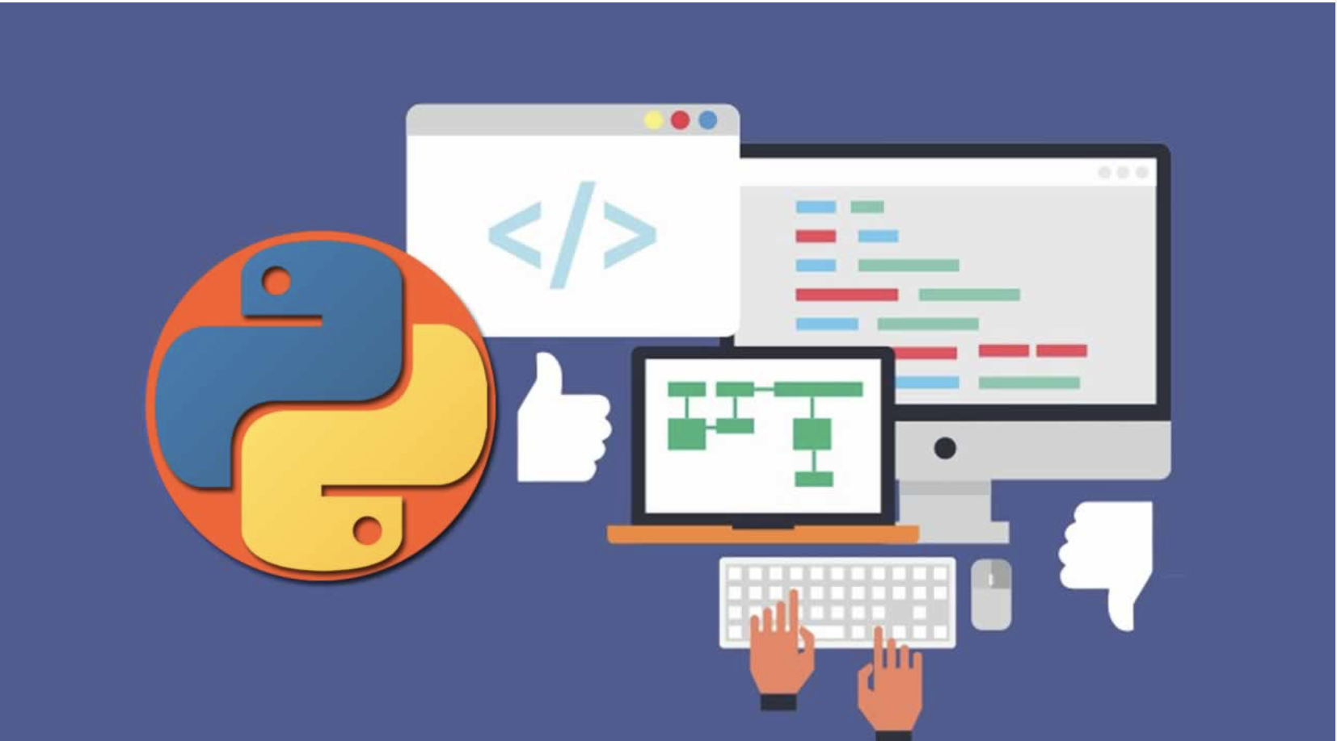
Advantages
Disadvantages
Improved productivity
Interpreted language
Dynamically Typed
Free and open source
Vast libraries support
Slow speed
Not memory efficient
Weak in mobile computing
Database access
Runtime errors
Eduard Tenev 18068235

Slide 4

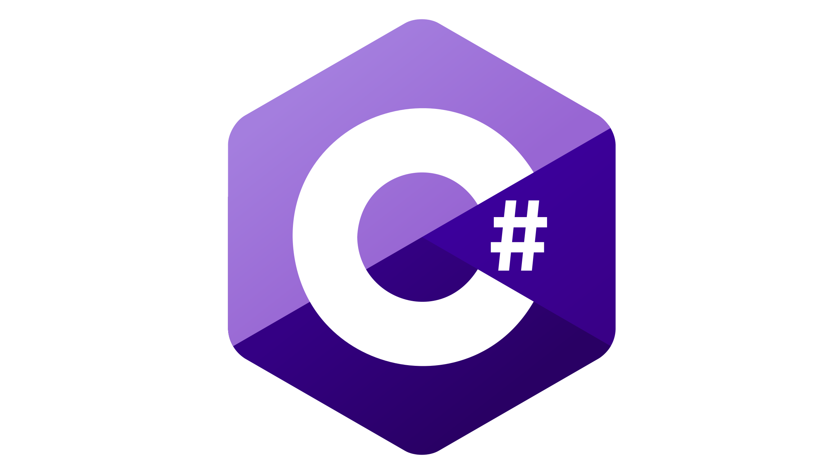

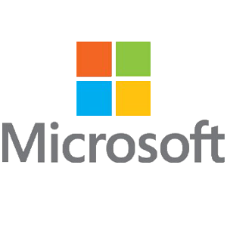

C# - The History
C# is an object oriented programming language that runs on the .NET Framework. It was developed by Anders Hejlsberg, a Danish software engineer working at Microsoft. Anders started Developing C# in 2002, and it was released in 2002 alongside Visual Studio 2002. Microsoft originally created C# for their own use, and was created as a rival to Java. It was released alongside Visual Studio 2002.
C# has always been a popular programming language for developing desktop applications, web applications and web services. Microsoft created C# for themselves, so creating Windows applications is very optimised when using it. This is due to features like garbage collection and how easy it is to utilise reusable components.
Notes:
C# is an object oriented programming language developed by Anders Hejlsberg. Anders is a Danish Software Engineer who works for Microsoft.
C# was created for Microsoft’s personal use, and was created as a rival to java. Development started in 2000, but C# was released to the public in 2002 alongside the release of Visual Studio 2002, Microsoft’s Development Environment.
Microsoft created C# for their own personal use, for things like desktop applications in Windows. The way C# handles garbage collection and how easy it is to utilise reusable components in C# makes it the perfect language for this.

Slide 5

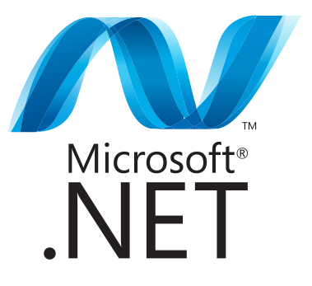
C# - How it’s used today
Presently, C# is very popular in the game development world. Unity, one of the most popular game development engines, is built using C++ and C#. C# can be integrated seamlessly into Unity, and although it isn’t required to create a game using Unity, utilising it will increase the quality of you game.
C# is also used in web development. As C# is an object-oriented programming language, websites created using it can be very efficient and easily maintained. C# can be used to create ASP.NET websites. ASP.NET is an open source web framework for .NET.
Notes:
C# is very popular when it comes to game development. One of the most popular game development engines, Unity, is built partly in C#. C# can also be integrated seamlessly into Unity, giving games more functionality and increasing the quality.
C# is also popular in web development. Being an object-oriented language makes websites created in C# extremely efficient and easily maintainable. C# can be used to create ASP.NET websites. ASP.NET is an open source web framework that

Slide 6


JavaScript
JavaScript create behaviour to the web pages.
JavaScript is very different than Java, like comparing to Car and Carpet.
JavaScript become the second of most popular programming language below Python in 2020.

Slide 7




History of JavaScript
Brendan Eich as Netscape programmer create Mocha in 1995 after 10 days of this project.
Mocha change to LiveScript after release in beta for Netscape 2.0, then change JavaScript because of popularly of Java in 1996.
Brendan Eich
Harry Pearce - 18136044

Slide 8

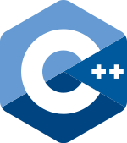
C++ Origins and History
Danish computer scientist Bjarne Stroustrup, is the man responsible for developing C++. Initially as an extension to C, later became it’s own language
Jessica Fealy - 18024092

Slide 9


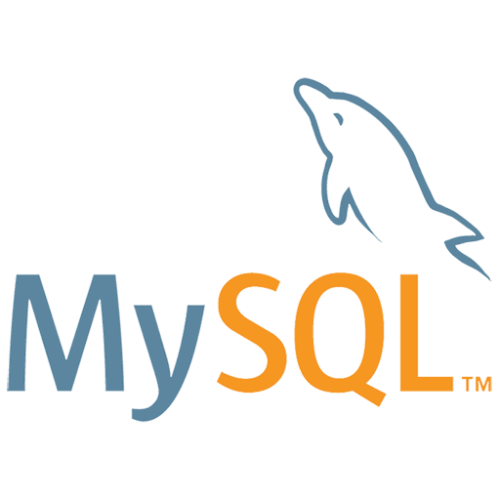



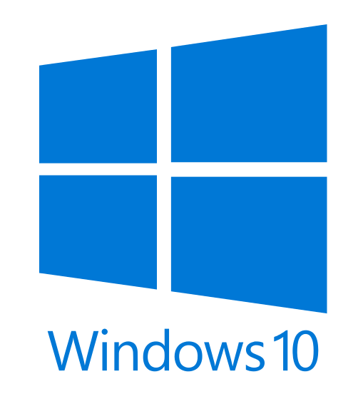

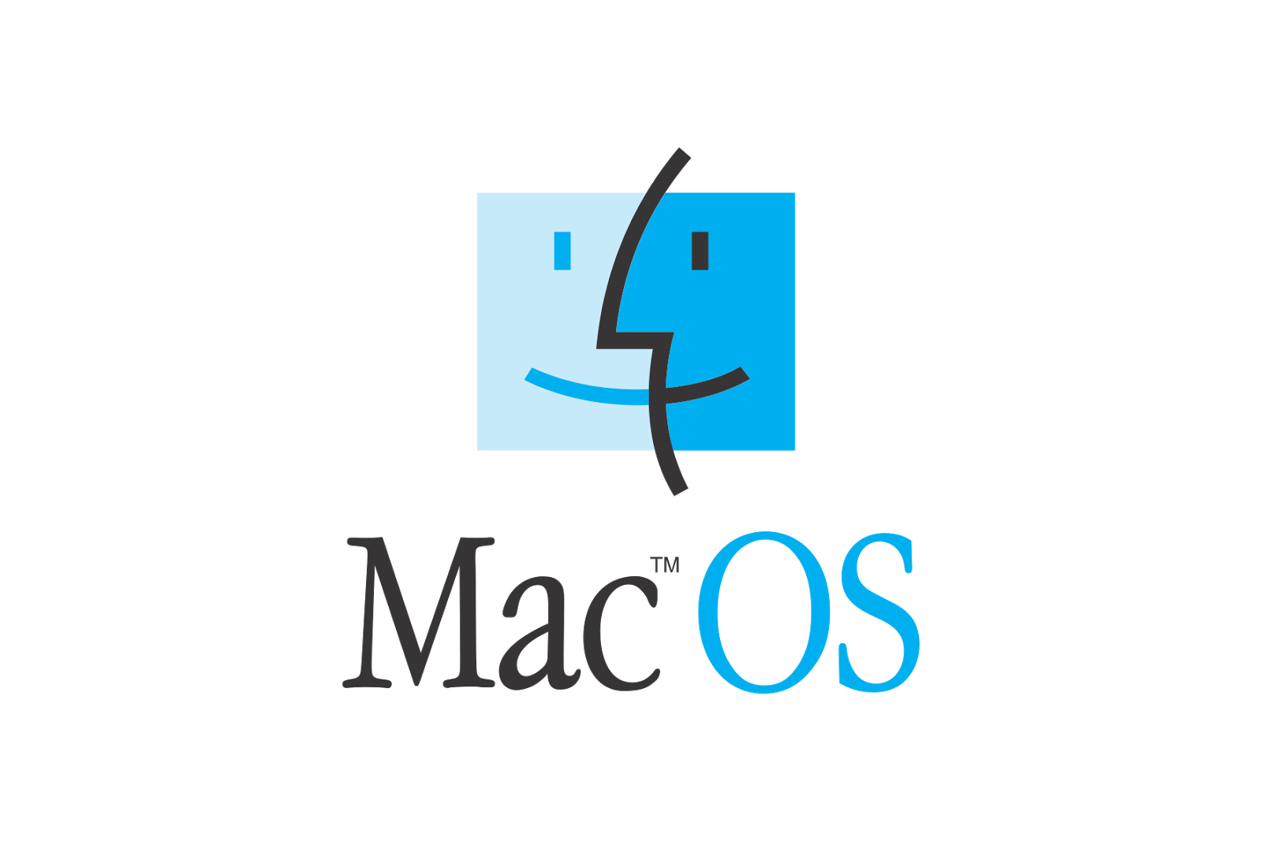

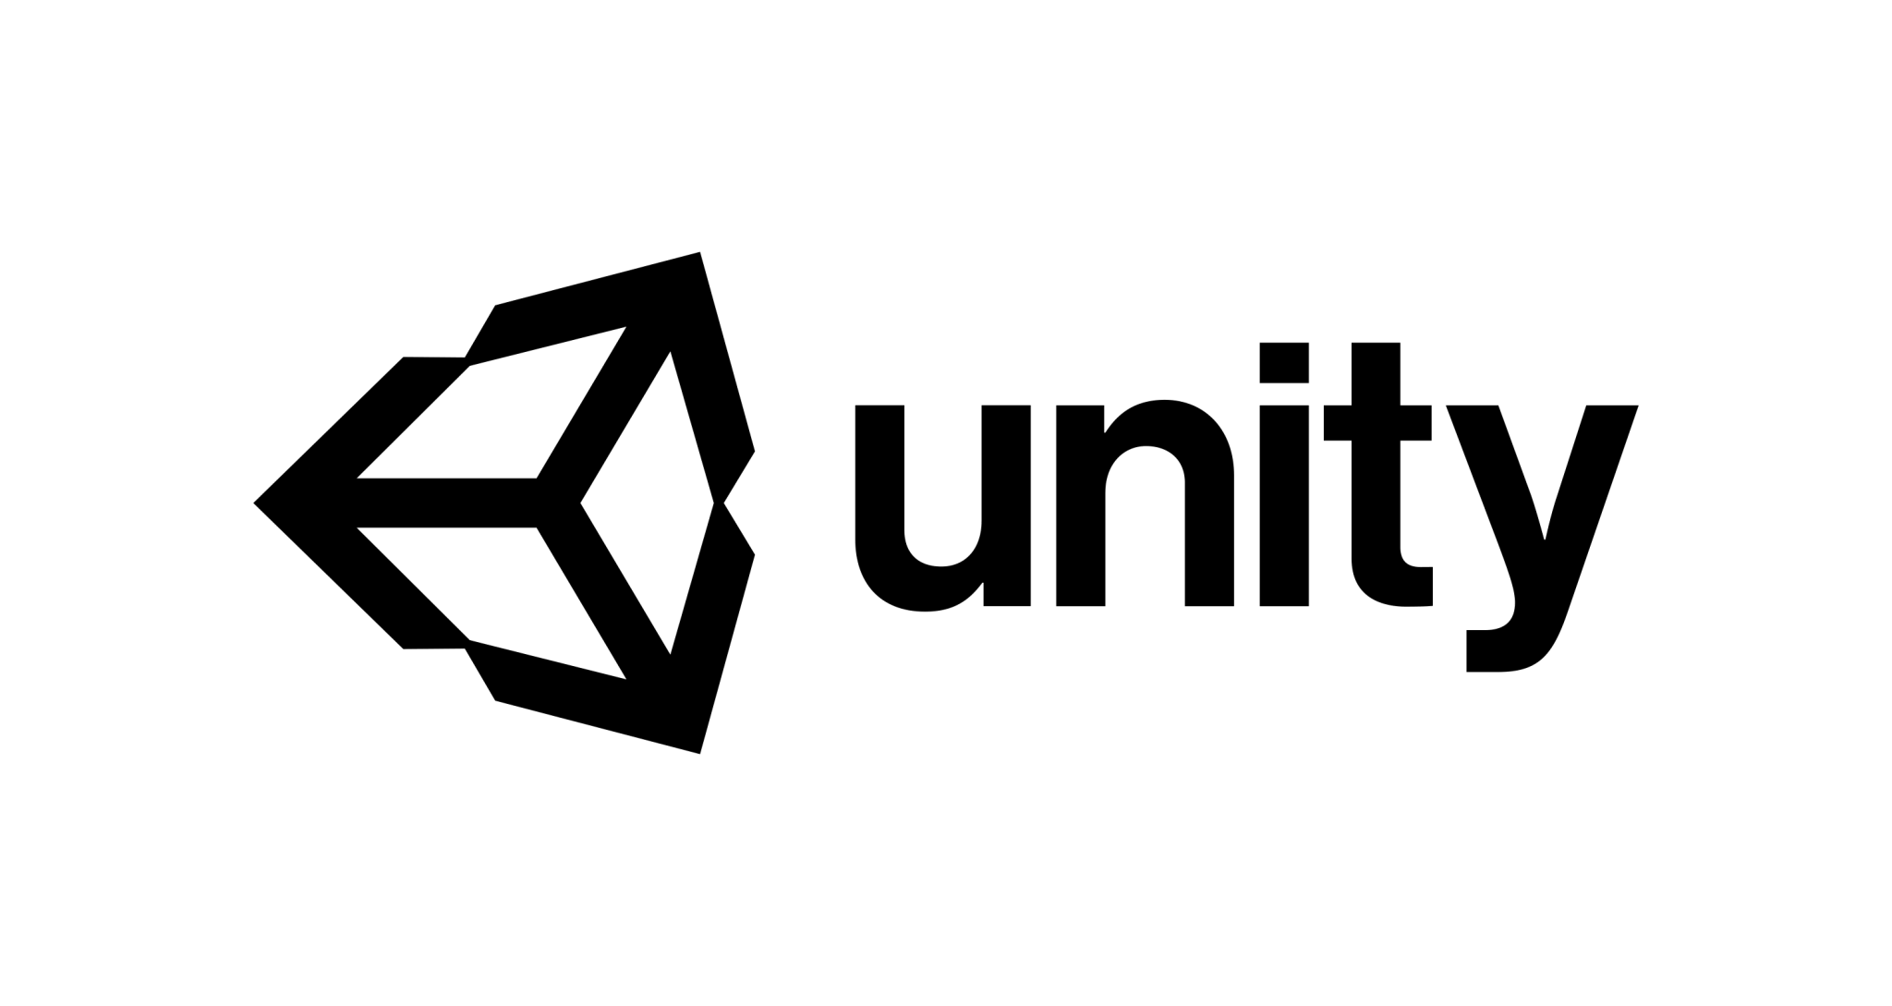


C++ Major uses
Many modern day applications will have a part of their development done in C++.
While most applications will have their consumer front face being operated by JavaScript or Python, their back ends will usually be written C++. This is the case for Spotify.
Some applications will exclusively use C++, such as Unity and Unreal Engines.
But every applications logo seen here use C++ in their development in one way, or another
Jessica Fealy - 18024092

Slide 10

Java
Java : creation (1991)
Object oriented programming language .
Main purpose: let application developer write once , run anywhere
(without any recompilation).
Dynamic capabilities (reflection and runtime code modification).
James Gosling , the creator of java
According to GitHub : most popular programming language ( in 2019).
komal - 30010813

